Slide 1
Chapter 10: Combinatorial Circuits
Notes:
In this chapter, we are going down to the logic gate level of the computer system that we will refer to as LG1. We are going to skip the Microcode 2 level for the moment and come back to it in Chapter 12.

Slide 2
Overview
Gates, latches, memories
used to design computer
Understanding of digital logic
Needed to learn computing systems organization and architecture
Two types of digital logic:
Combinatorial logic: output is a function of inputs
Sequential logic: output is a complex function of inputs, previous inputs and previous outputs
Both are used in circuit design
Notes:
Gates, latches, memories and other logic components are used to design computer systems and their subsystems
Good understanding of digital logic is necessary in order to learn the fundamentals of computing systems organization and architecture
Two types of digital logic:
Combinatorial logic: output is a function of inputs
Sequential logic: output is a complex function of inputs, previous inputs and previous outputs (chapter 11)
Neither combinatorial logic or sequential logic is better than the other. In practice, both are used as appropriate in circuit design.

Slide 3
Combinatorial logic
Output is dependent on its current inputs
When certain input values are set
Generates output values corresponding to those input values
When the input values are changed
Outputs are also changed to reflect the changes in the new input values
Previous values of the inputs do not matter
current outputs depend solely on the current inputs
Notes:
First let’s look at Combinatorial logic. The output of this type of logic is dependent solely on its current inputs.
When certain input values are set, a combinatorial circuit generates output values corresponding to those input values.
When the input of the combinatorial logic are changed, the outputs are also changed to reflect the changes in the new input values.
Previous values of the inputs do not matter, the current outputs depend solely on the current inputs.

Slide 4
Sequential logic
Outputs depend on both the current inputs and on previous inputs and outputs of the circuit
Sequential elements have storage elements that record the state of the circuit.
State information combined with the inputs generates outputs
State and inputs also combine to generate a new state of the circuit
Same inputs may generate different outputs and different new states, depending on current state
Both types of logic are used
Sequential logic includes combinatorial logic
the reverse is not true
Notes:
Now let compare to Sequential logic. The outputs of a sequential logic circuit depend on both the current inputs and on previous inputs and outputs of the circuit.
Sequential elements have storage elements that record the state of the circuit.
In other words, the state information combined with the inputs is generating the outputs.
The state and inputs also combine to generate a new state of the circuit.
The same inputs in a sequential circuit may generate different outputs and different new states, depending on the circuit’s current state.
In practice both types of logic are used. The sequential logic includes combinatorial logic…the reverse is not true.

Slide 5
Boolean Algebra
Boolean algebra is a mathematical system that can have one of two values
Formal logic: “true” and “false”
Digital systems:
“on” and “off”
1 and 0
“high” and “low.”
Boolean expressions created by performing operations on Boolean variables
Common Boolean operators
AND, OR, and NOT
Notes:
Boolean algebra is a mathematical system for the manipulation of variables that can have one of two values.
In formal logic, these values are “true” and “false.”
In digital systems, these values are “on” and “off,” 1 and 0, or “high” and “low.”
Boolean expressions are created by performing operations on Boolean variables.
Common Boolean operators include AND, OR, and NOT.

Slide 6
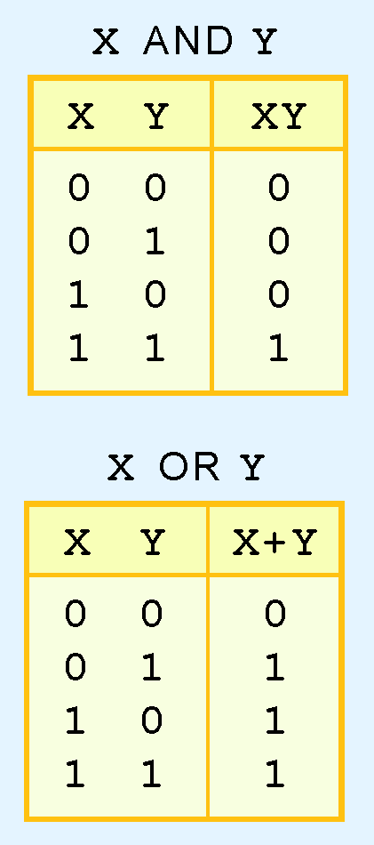
Boolean Algebra
Boolean operator
described using truth table
AND operator
Boolean product
OR operator
Boolean sum
Notes:
A Boolean operator can be completely described using a truth table.
The truth table for the Boolean operators AND and OR are shown at the right.
The AND operator is also known as a Boolean product. The OR operator is the Boolean sum.

Slide 7
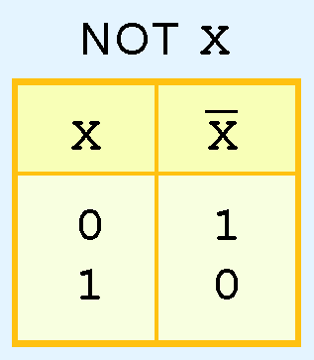
Boolean Algebra
NOT operation
designated by an overbar
sometimes a prime mark
X'
sometimes an “elbow”
¬X
Notes:
The truth table for the Boolean NOT operator is shown at the right.
The NOT operation is most often designated by an overbar. It is sometimes indicated by a prime mark ( ‘ ) or an “elbow” (¬).

Slide 8
Boolean Algebra
A Boolean function has:
At least one Boolean variable
At least one Boolean operator
At least one input from the set {0,1}
Output produced is also a member of set {0,1}
Notes:
A Boolean function has:
At least one Boolean variable,
At least one Boolean operator, and
At least one input from the set {0,1}.
It produces an output that is also a member of the set {0,1}.

Slide 9
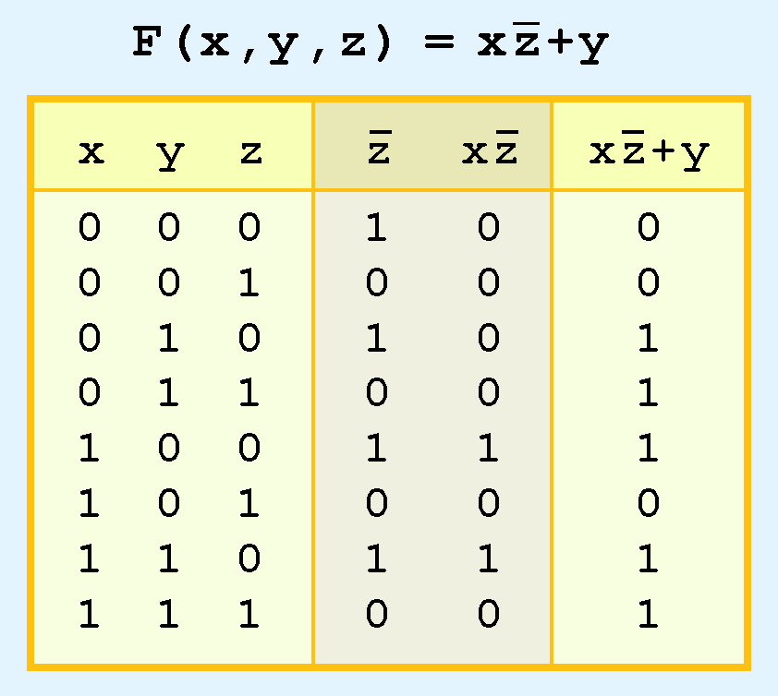
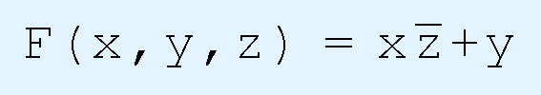
Boolean Algebra
Truth table for the Boolean function:
Ease evaluation
Add extra (shaded) columns to hold evaluations of subparts of function
Notes:
The truth table for the Boolean function:
F of x,y,z = x and not z or y is shown at the right.
To make evaluation of the Boolean function easier, the truth table contains extra (shaded) columns to hold evaluations of subparts of the function.
Here the column not z has been added and here x and not z.

Slide 10
Boolean Algebra
Boolean operations have rules of precedence
NOT
highest priority
AND
Next highest
OR
last
Extra (shaded) function subparts for highest priorities
Notes:
As with common arithmetic, Boolean operations have rules of precedence.
The NOT operator has highest priority, followed by AND and then OR.
This is how we chose the (shaded) function subparts in our table by picking the highest priorities first.
Just like in Algebra you would work the parts inside the parentheses first.

Slide 11
Boolean Algebra
Digital computers contain circuits that implement Boolean functions
The simpler the Boolean function
The smaller the circuit that will result
Simpler circuits are:
cheaper to build
consume less power
run faster than complex circuits
Always reduce Boolean functions to their simplest form
Boolean identities help to do this
Notes:
Digital computers contain circuits that implement Boolean functions.
The simpler that we can make a Boolean function, the smaller the circuit that will result.
Simpler circuits are cheaper to build, consume less power, and run faster than complex circuits.
With this in mind, we always want to reduce our Boolean functions to their simplest form.
There are a number of Boolean identities that help us to do this.

Slide 12
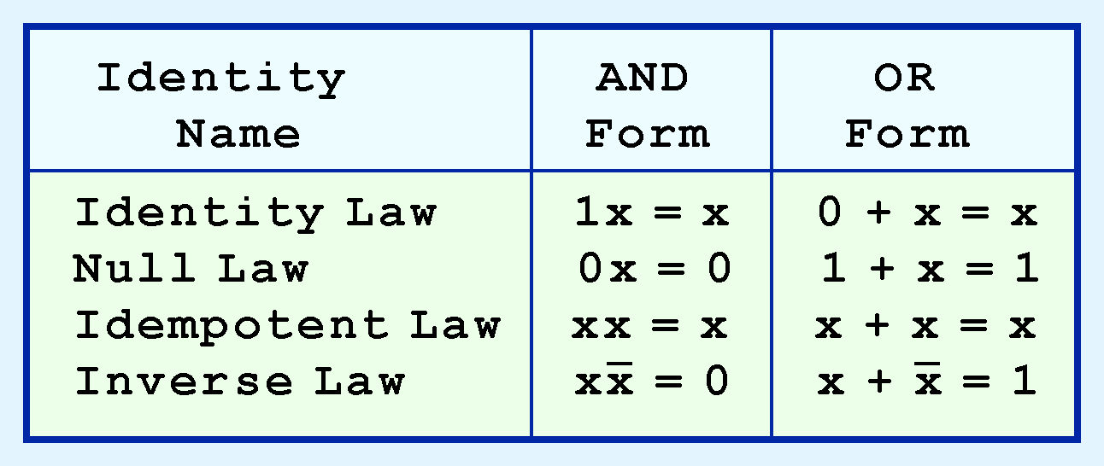
Boolean Algebra
Most Boolean identities have an AND (product) form as well as an OR (sum) form
Here are identities using both forms
This group is rather intuitive
Notes:
Most Boolean identities have an AND (product) form as well as an OR (sum) form. We give our identities using both forms. Our first group is rather intuitive: (Remember that x can only be 0 or 1 here)
Identity Law – 1 and x equals x, 0 or x equals x
Null Law – 0 and x equals 0, 1 or x equals 1
Idempotent Law – x and x equals x, x or x equals x
Inverse Law – X and not X equals 0 , x or not x equals 1

Slide 13
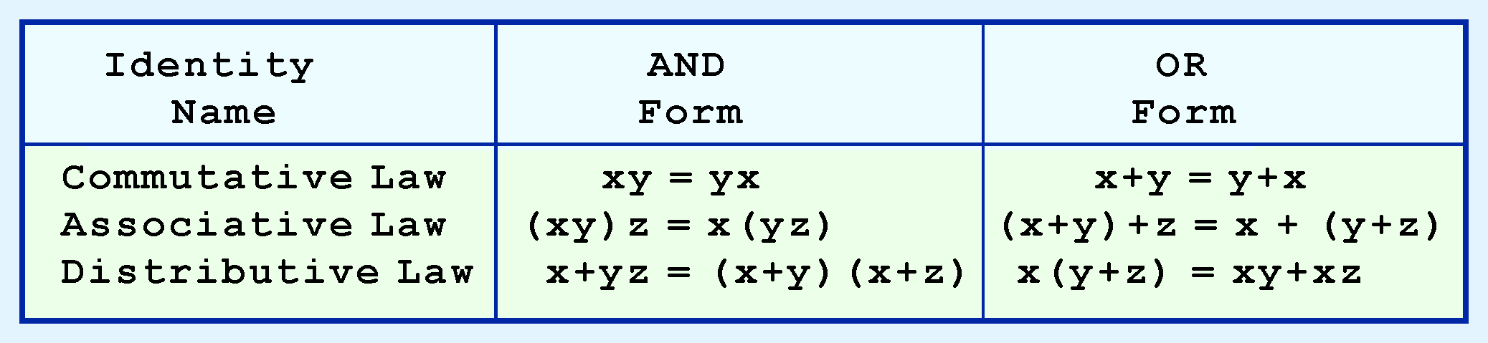
Boolean Algebra
Second group of Boolean identities should be familiar from algebra:
Notes:
Our second group of Boolean identities should be familiar to you from your study of algebra:
Commutative Law: x AND y equals y AND x, x OR y equals y OR x
And the Associative Law and the Distributive Law

Slide 14
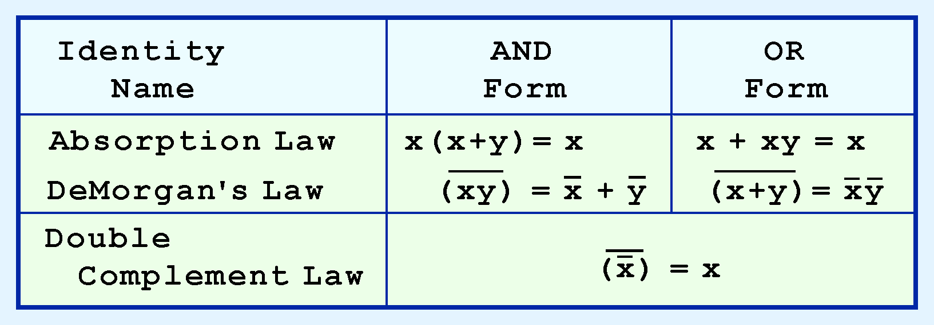
Boolean Algebra
Last group of Boolean identities are the most useful
If you have studied set theory or formal logic, these laws are also familiar to you
Notes:
Our last group of Boolean identities are perhaps the most useful.
If you have studied set theory or formal logic, these laws are also familiar to you.
Absorption Law
DeMorgan’s Law
Double Complement Law

Slide 15

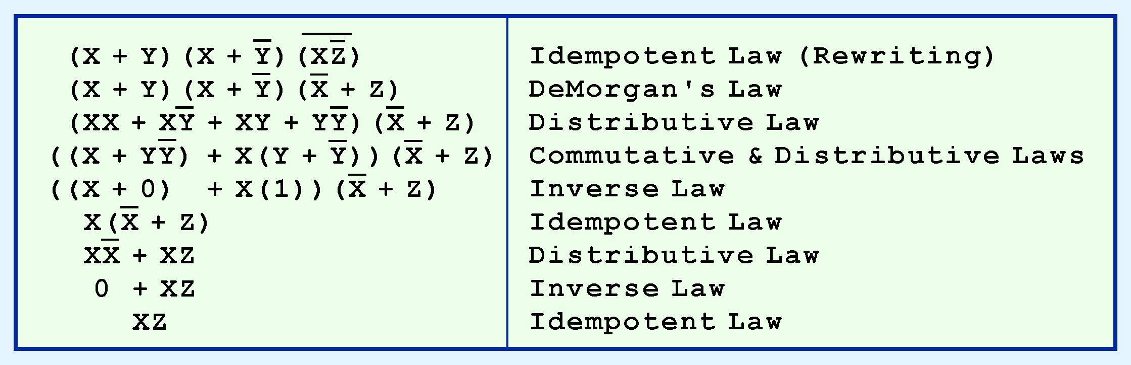
3.2 Boolean Algebra
Boolean Algebra
Use Boolean identities to simplify the function:
as follows:
Notes:
We can use Boolean identities to simplify the function as shown in the example.

Slide 16
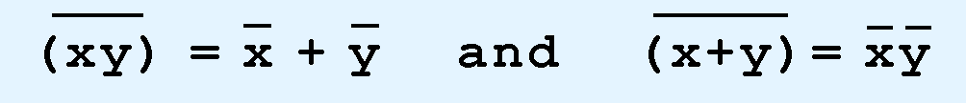
Boolean Algebra
Sometimes economical to build a circuit using the complement than to implement the function directly
DeMorgan’s law
provides way to find complement of Boolean function
DeMorgan’s law states:
Notes:
Sometimes it is more economical to build a circuit using the complement of a function (and complementing its result) than it is to implement the function directly.
DeMorgan’s law provides an easy way of finding the complement of a Boolean function.
Recall DeMorgan’s law states:
not x and y equals not x or not y
And also not x or y equals not x and not y

Slide 17
DeMorgan’s Law
(ab)’=a’+b’
(a+b)’=a’b’
Allows conversion of AND function
to equivalent OR function and vice-versa
May allow simplification of complex functions
that will allow simpler design
Notes:
DeMorgan’s Law also allows conversion of AND function to an equivalent OR function and vice-versa
It may allow the simplification of complex functions, that will allow a simpler design

Slide 18
Generating the complement of a function using DeMorgan’s law
(xy’ + yz)’ = (xy’)’(yz)’ = (x’ + y)(y’ + z’) = x’y’ + x’z’ + yy’ + yz’ (because yy’=0) => (xy’+yz)’ = x’y’ + x’z’ + yz’
x | y | z | x'y' | x'z' | yz' | x'y‘ + y'z‘ + yz'
0 | 0 | 0 | 1 | 1 | 0 | 1
0 | 0 | 1 | 1 | 0 | 0 | 1
0 | 1 | 0 | 0 | 1 | 1 | 1
0 | 1 | 1 | 0 | 0 | 0 | 0
1 | 0 | 0 | 0 | 0 | 0 | 0
1 | 0 | 1 | 0 | 0 | 0 | 0
1 | 1 | 0 | 0 | 0 | 1 | 1
1 | 1 | 1 | 0 | 0 | 0 | 0
Notes:
Here you can see an example where the long equation on the top is simplified to a much shorter equation using DeMorgan’s law.

Slide 19
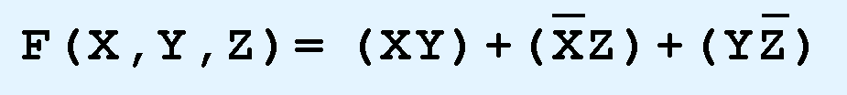
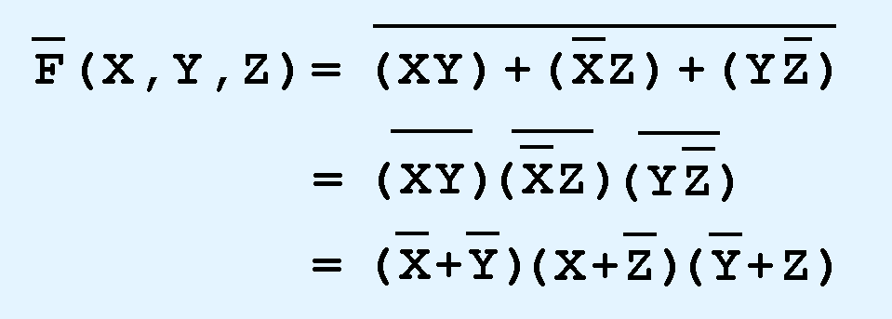
Boolean Algebra
DeMorgan’s law can be extended to any number of variables.
Replace each variable by its complement and change all ANDs to ORs and all ORs to ANDs.
Thus, we find the the complement of:
is:

Slide 20
Boolean Algebra
Numerous ways of stating the same Boolean expression
“synonymous” forms are logically equivalent
Logically equivalent expressions have identical truth tables
To eliminate confusion:
Boolean functions are expressed in standardized or canonical form
Notes:
Through our exercises in simplifying Boolean expressions, we see that there are numerous ways of stating the same Boolean expression.
These “synonymous” forms are logically equivalent.
Logically equivalent expressions have identical truth tables.
In order to eliminate as much confusion as possible, designers express Boolean functions in standardized or canonical form.

Slide 21
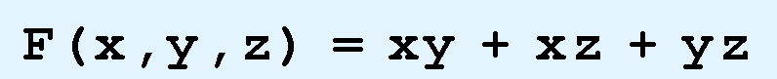
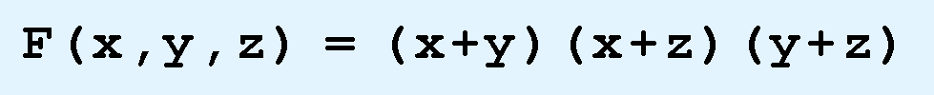
Boolean Algebra
Two canonical forms for Boolean expressions:
sum-of-products
product-of-sums
Recall:
Boolean product is the AND operation
Boolean sum is the OR operation
Sum-of-products form:
ANDed variables are ORed together.
For example:
Product-of-sums form:
ORed variables are ANDed together:
For example:
Notes:
There are two canonical forms for Boolean expressions: sum-of-products and product-of-sums.
Recall the Boolean product is the AND operation and the Boolean sum is the OR operation.
In the sum-of-products form, ANDed variables are ORed together.
Here is an example:
In the product-of-sums form, ORed variables are ANDed together:
Here is an example:

Slide 22
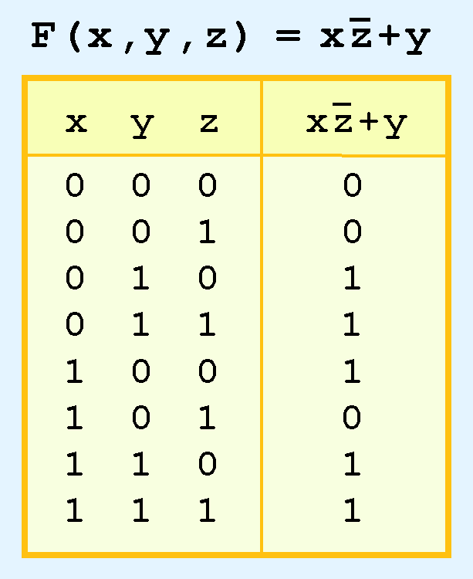
Boolean Algebra
Convert a function to sum-of-products form using its truth table
Note values of the variables that make the function true (=1)
List the values of the variables that result in a true function value
Each group of variables is then ORed together
Notes:
It is easy to convert a function to sum-of-products form using its truth table.
We are interested in the values of the variables that make the function true (=1).
Using the truth table, we list the values of the variables that result in a true function value.
Each group of variables is then ORed together.

Slide 23
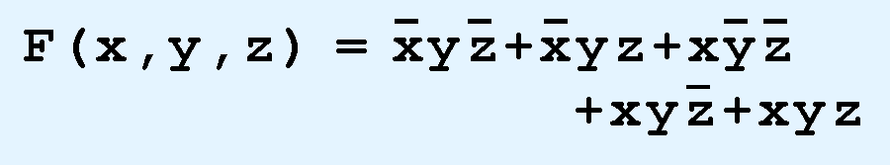
Boolean Algebra
Sum-of-products form for our function is:
Note: this function is not in simplest terms. Our aim is only to rewrite our function in canonical sum-of-products form.
Notes:
The sum-of-products form for our function looks like this
We note that this function is not in simplest terms. Our aim is only to rewrite our function in canonical sum-of-products form.

Slide 24
Logic Gates
Boolean functions in abstract terms so far
Boolean functions are implemented in digital computer circuits called gates
Gate - electronic device that produces a result based on two or more input values
Gates consist of one to six transistors
digital designers think of them as a single unit
Integrated circuits contain collections of gates
Notes:
We have looked at Boolean functions in abstract terms.
In this section, we see that Boolean functions are implemented in digital computer circuits called gates.
A gate is an electronic device that produces a result based on two or more input values.
In reality, gates consist of one to six transistors, but digital designers think of them as a single unit.
Integrated circuits contain collections of gates suited to a particular purpose.
Let’s look at how the Boolean Algebra functions can be implemented as circuits.

Slide 25
AND
x | y | out = xy
0 | 0 | 0
1 | 0 | 0
0 | 1 | 0
1 | 1 | 1
Output is one if every input has value of 1
More than two values can be “and-ed” together
For example xyz = 1 only if x=1, y=1 and z=1
Notes:
Here is the truth table for AND and the circuit symbol for it.
The signal trace shows how two signal inputs are anded together to produce the output.
An AND can have more than two inputs and its output will be 1 only if ALL of the inputs are 1.

Slide 26
OR
x | y | out = x+y
0 | 0 | 0
1 | 0 | 1
0 | 1 | 1
1 | 1 | 1
Output is 1 if at least one input is 1.
More than two values can be “or-ed” together.
For example x+y+z = 1 if at least one of the three values is 1.
Notes:
Here is the truth table for OR and the circuit symbol for it.
The signal trace shows how two signal inputs are ORed together to produce the output.
An OR can have more than two inputs and its output will be 1 if at least one of the inputs are 1.

Slide 27
XOR (Exclusive OR)
x | y | out =
0 | 0 | 0
1 | 0 | 1
0 | 1 | 1
1 | 1 | 0
The number of inputs that are 1 matter.
More than two values can be “xor-ed” together.
General rule: the output is equal to 1 if an odd number of input values are 1 and 0 if an even number of input values are 1.
Notes:
Here is the truth table for an Exclusive OR and the circuit symbol for it.
The signal trace shows how two signal inputs are XORed together to produce the output.
An XOR can have more than two inputs and its output will be 1 if an odd # of the inputs are 1 and 0 if an even # of inputs are 1.

Slide 28
NOT
x | x'
0 | 1
1 | 0
0 | 1
1 | 0
This function operates on a single Boolean value.
Its output is the complement of its input.
An input of 1 produces an output of 0 and an input of 0 produces an output of 1
Notes:
Here is the truth table for NOT and the circuit symbol for it.
The signal trace shows how one signal input is inverted to produce the output.
NOT can only have one input and its output will be the complement of its input.
An input of 1 will output 0 and an input or 0 will output 1.

Slide 29
NAND
x | y | out = x NAND y
0 | 0 | 1
1 | 0 | 1
0 | 1 | 1
1 | 1 | 0
Output value is the complemented output from an “AND” function.
Notes:
Here is the truth table for NAND and the circuit symbol for it.
The signal trace shows how two signal inputs are nanded together to produce the output.
The little circle at the output indicates that it is the complement of AND .

Slide 30
NOR
x | y | out = x NOR y
0 | 0 | 1
1 | 0 | 0
0 | 1 | 0
1 | 1 | 0
Output value is the complemented output from an “OR” function.
Notes:
Here is the truth table for NOR and the circuit symbol for it.
The signal trace shows how two signal inputs are NORed together to produce the output.
The little circle at the output indicates that it is the complement of OR .

Slide 31
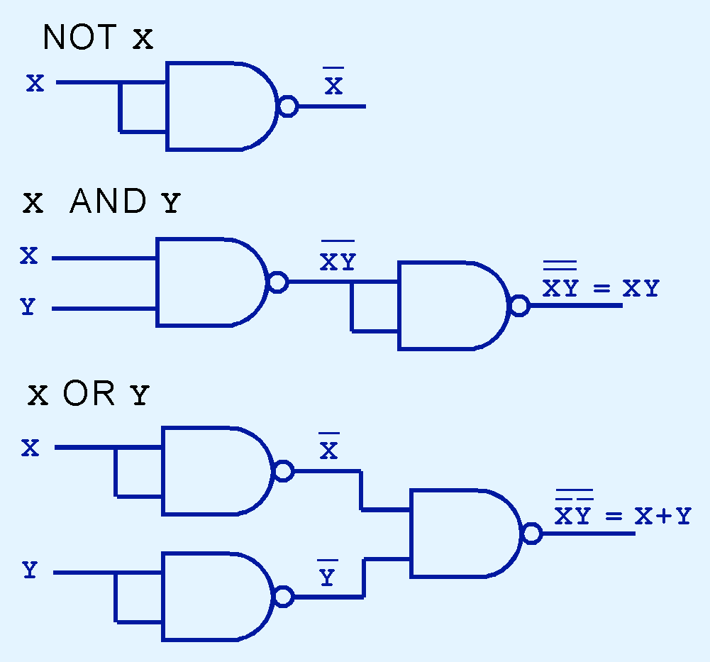
Logic Gates
NAND and NOR
universal gates
inexpensive to manufacture
Any Boolean function can be constructed using only NAND or only NOR gates.
Notes:
NAND and NOR are known as universal gates because they are inexpensive to manufacture and any Boolean function can be constructed using only NAND or only NOR gates.

Slide 32
XNOR
x | y | out =x xnor y
0 | 0 | 0
1 | 0 | 1
0 | 1 | 1
1 | 1 | 0
Output value is the complemented output from an “XOR” function.
Notes:
Here is the truth table for XNOR and the circuit symbol for it.
The signal trace shows how two signal inputs are XNORed together to produce the output.
The little circle at the output indicates that it is the complement of XOR .

Slide 33
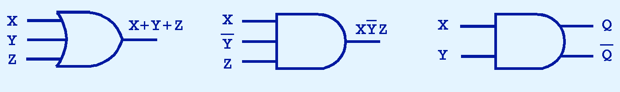
Logic Gates
Gates:
Can have multiple inputs
Can have multiple outputs
A second output can provide the complement of the operation
Notes:
Gates can have multiple inputs and more than one output.
A second output can be provided for the complement of the operation.
We’ll see more of this later.

Slide 34

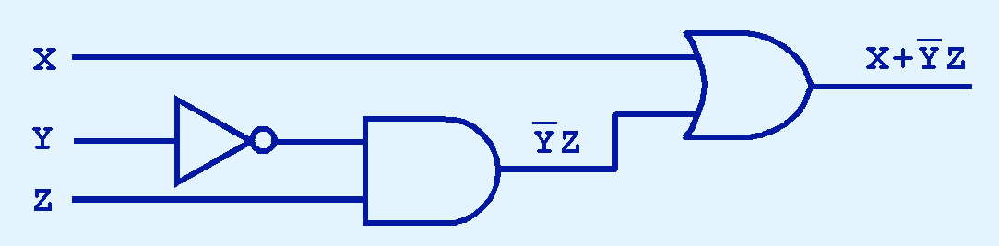
Digital Components
Combinations of gates implement Boolean functions
The circuit below implements the Boolean function:
We simplify our Boolean expressions so that we can create simpler circuits.
Notes:
The main thing to remember is that combinations of gates implement Boolean functions.
The circuit below implements the Boolean function:
We simplify our Boolean expressions so that we can create simpler circuits.
Simpler circuits are cheaper to build.

Slide 35
Combinational Circuits
Designed a circuit that implements the Boolean function:
Example of a combinational logic circuit
Combinational logic circuits produce a specified output (almost) at the instant when input values are applied
Notes:
We have designed a circuit that implements the Boolean function:
This circuit is an example of a combinational logic circuit.
Combinational logic circuits produce a specified output (almost) at the instant when input values are applied.
In a later section, we will explore circuits where this is not the case

Slide 36
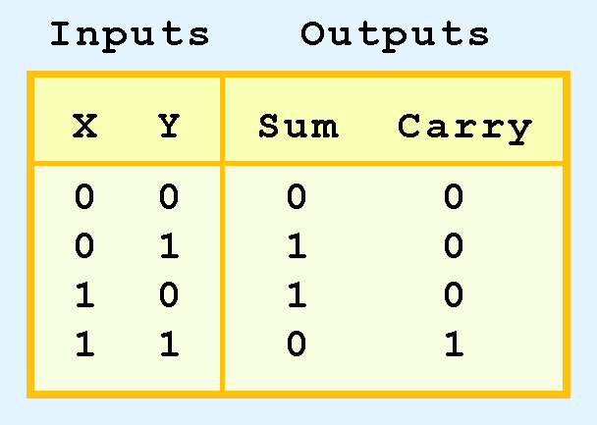
Combinational Circuits
Combinational logic circuits provide many useful devices
HALF ADDER - which finds the sum of two bits
HALF ADDER construction shown by its truth table
Notes:
Combinational logic circuits provide many useful devices.
One of the simplest is the half adder, which finds the sum of two bits.
We can gain some insight as to the construction of a half adder by looking at its truth table, shown at the right.
You can see the Carry indicates the overflow.

Slide 37
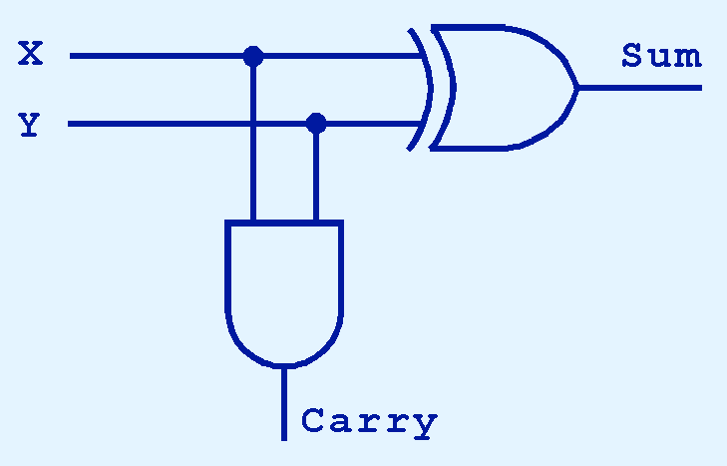
Combinational Circuits
Sum found using the XOR operation
Carry found using the AND operation
Notes:
As we see, the sum can be found using the XOR operation and the carry using the AND operation.

Slide 38
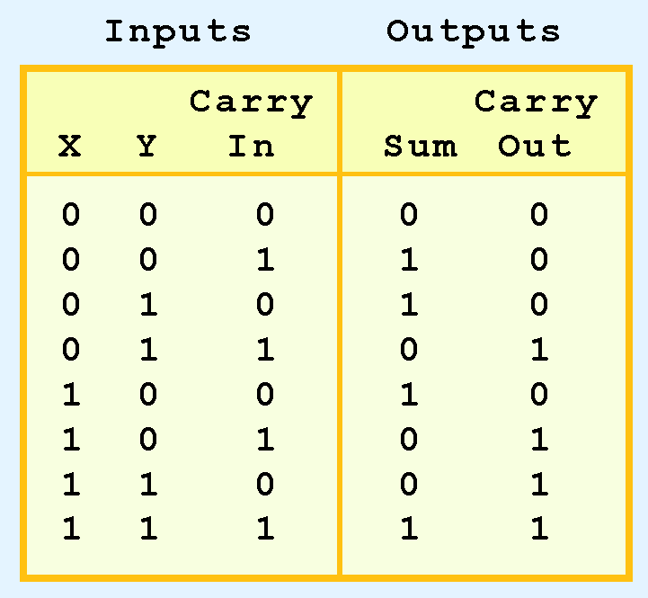
Combinational Circuits
Change HALF ADDER to FULL ADDER
include gates for processing carry in bit
Truth table for a full adder is shown at the right
Notes:
We can change our half adder into to a full adder by including gates for processing the carry in bit.
The truth table for a full adder is shown at the right.

Slide 39
Combinational Circuits
How can we change the half adder shown below to make it a full adder?
Notes:
How can we change the half adder shown below to make it a full adder?

Slide 40
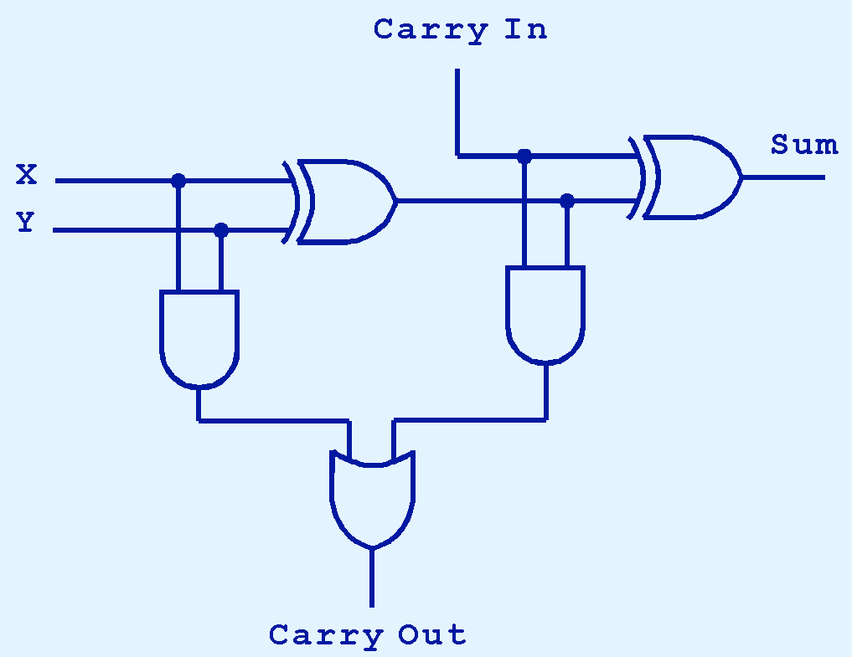
Combinational Circuits
Here is the completed FULL ADDER
Notes:
Here is the completed FULL ADDER
Note this only adds one digit.

Slide 41

Combinational Circuits
FULL ADDERS can connected in series
Carry bit “ripples” from one adder to the next
Called a ripple-carry adder
Today’s systems employ more efficient adders.
Notes:
Just as we combined half adders to make a full adder, full adders can connected in series.
The carry bit “ripples” from one adder to the next; hence, this configuration is called a ripple-carry adder.
Today’s systems employ more efficient adders.

Slide 42
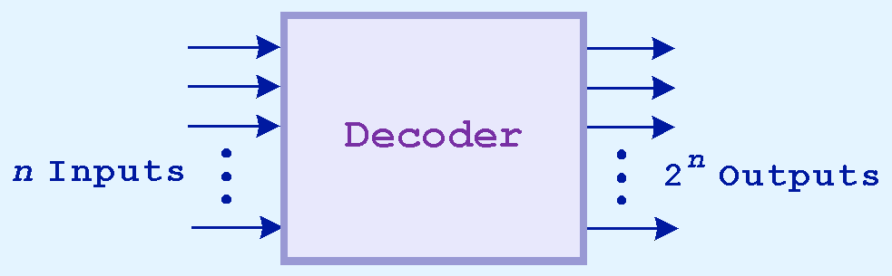
Combinational Circuits
Decoders –
another important type of combinational circuit.
Useful in selecting a memory location
according a binary value placed on the address lines of a memory bus
Address decoders with n inputs can select any of 2^{n} locations
This is a block diagram for a decoder.
Notes:
Decoders are another important type of combinational circuit.
Among other things, they are useful in selecting a memory location according a binary value placed on the address lines of a memory bus.
Address decoders with n inputs can select any of 2^{n} locations.
Often block diagrams are used as an abstraction to represent the circuits inside.

Slide 43
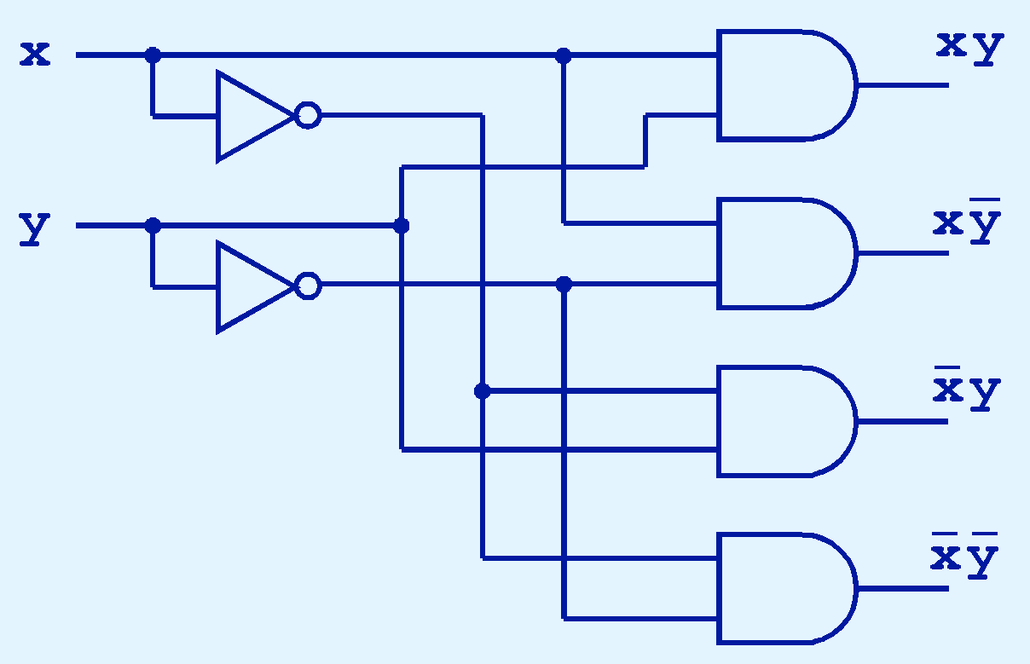
Combinational Circuits
This is what a 2-to-4 decoder looks like on the inside.
If x = 0 and y = 1, which output line is enabled?
Notes:
This is what a 2-to-4 decoder looks like on the inside.
If x = 0 and y = 1, which output line is enabled?
This one because not x equals 1 – so not x and y will be 1 – enabling this line

Slide 44
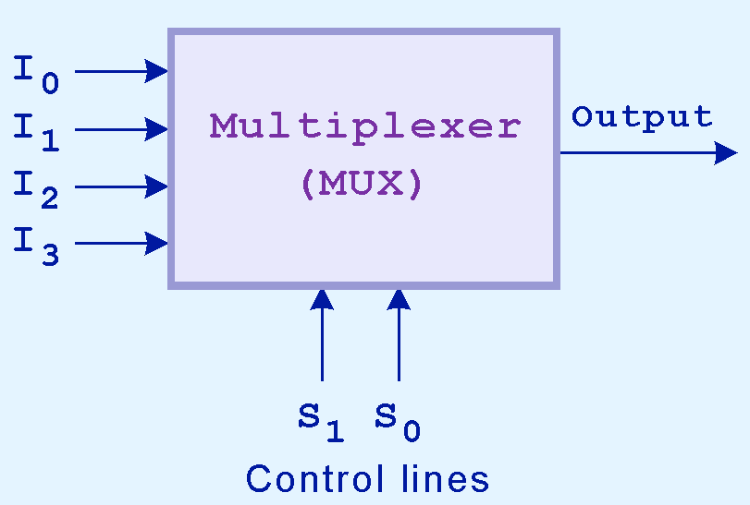
Combinational Circuits
Multiplexer
opposite of a decoder
Selects a single output from several inputs
Particular input chosen for output
determined by the value of the multiplexer’s control lines
To select among n inputs
log₂n control lines are needed
This is a block diagram for a multiplexer.
Notes:
A multiplexer does just the opposite of a decoder.
It selects a single output from several inputs.
The particular input chosen for output is determined by the value of the multiplexer’s control lines.
To be able to select among n inputs, log₂n control lines are needed.

Slide 45
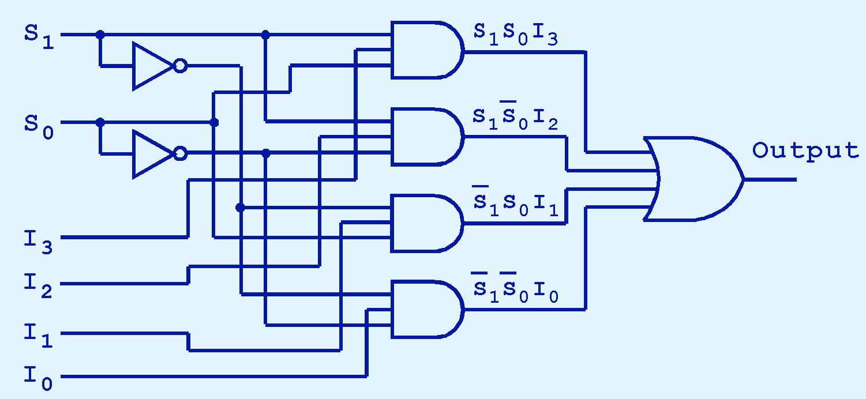
Combinational Circuits
This is what a 4-to-1 multiplexer looks like on the inside.
If S₀ = 1 and S₁ = 0, which input is transferred to the output?
Notes:
This is what a 4-to-1 multiplexer looks like on the inside.
If S₀ = 1 and S₁ = 0, which input is transferred to the output?
I1

Slide 46
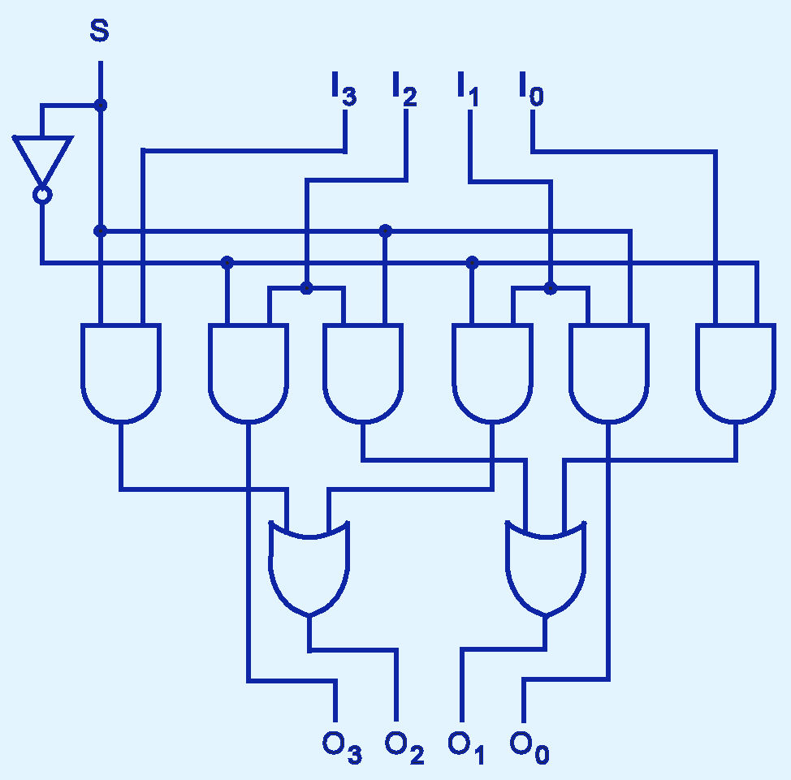
Combinational Circuits
This shifter moves the bits of a nibble one position to the left or right.
If S = 0, in which direction do the input bits shift?
Notes:
This shifter moves the bits of a nibble one position to the left or right.
If S = 0, in which direction do the input bits shift?
Left
Karnaugh Maps are a powerful tool to simplify circuits. Please review the lecture on Karnaugh Maps next, before doing the quiz and the homework.

